Slide 1
Software Architecture Design and Design Patterns
(Car Rental System)
Professor: Xudong He
Students: Bo Shao
XiaoLi Liang
April 18, 2006

Slide 2
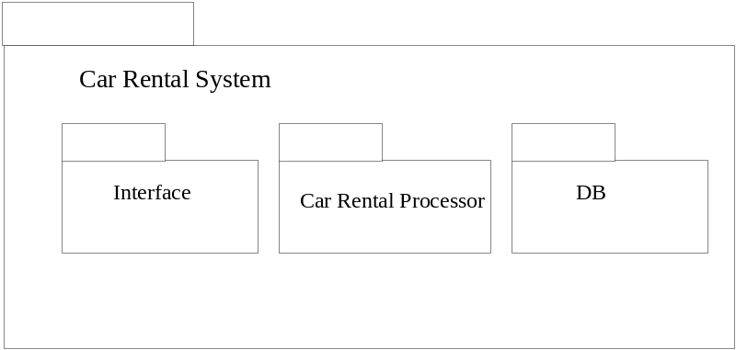
Software Architecture Design-Module View
Style: Decomposition
Element: Package and classes
Notes:
In decomposition styles, the whole system (Car Rental System) can be decomposed into three subsystems: Car Rental Process, Interface, and DB

Slide 3
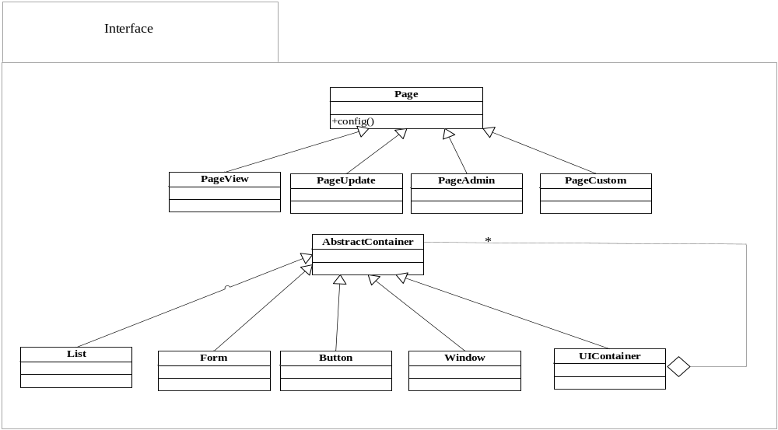
Software Architecture Design-Module View
Classes-Interface

Slide 4
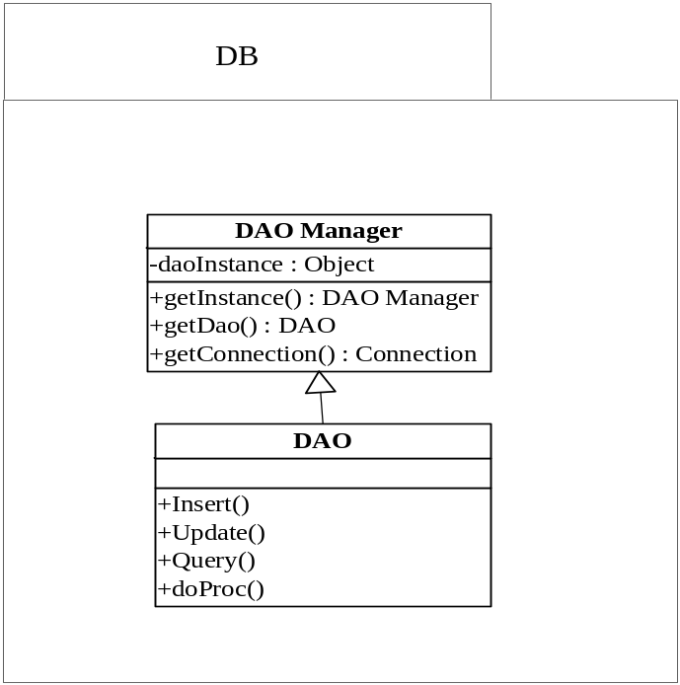
Software Architecture Design-Module View
Classes-DB

Slide 5
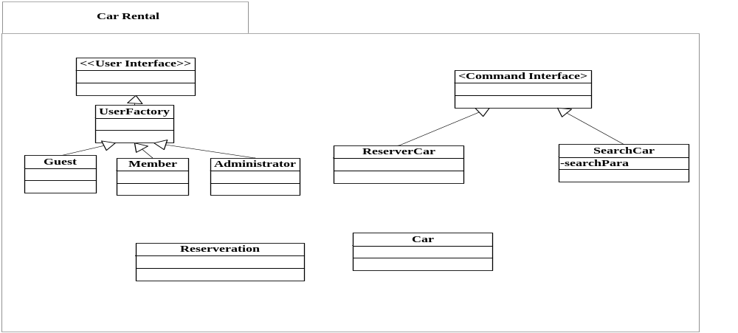
Software Architecture Design-Module View
Classes-Car Rental

Slide 6
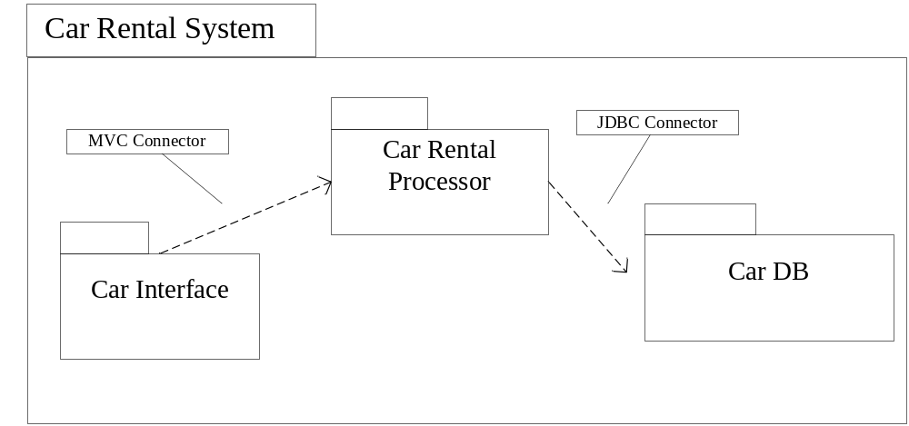
Software Architecture Design-C&C View
Style: Client - Server
Notes:
In car rental system, we use a client-server style. In addition, we use a special case of a client-server style, an N-tiered client-server model. In this case clients and servers form a three level hierarchy. The first tier is called view/control tier which consists of client application. The second tier is called model tier and it provides all “business logic” services. The third tier provides data management services. And every upper tier consisting of clients that invoke servers in tiers below.
We now use a subsystem (a stereotyped UML package) to describe the components in car retinal system and the component types in a 3-tiered client-server style.

Slide 7
Software Architecture Design-C&C View
Component Name & Type
Connector Name & Type
Interface | client
Car Rental Process | Client & server
Car DB | Server
MVC | HTTP
JDBC | JDBC
Notes:
Interface
It is the MVC client, and invokes the service request to Car Rental Process.
Car Rental Process
It is the MVC server when receive the request from interface and reply the service result to MVC client (interface).
It is also the JDBC client, which invokes the SQL request to Car DB.
Car DB
It is the JDBC Service Server, which is for providing all SQL operations service.

Slide 8
Design Patterns - Overview
Behavioral Patterns
Command, Strategy
Structural Patterns
Composite
Creational Patterns
Factory, Singleton
Notes:
Different users will own different page style. Through method of config() we can provide different implementations of the same behavior. In this systems, we provide the pageview strategy for guests, pageUpdate for member, pageAdmin for administrator.The pageCustom is applied in some uses who can custom their favorite interface style.

Slide 9
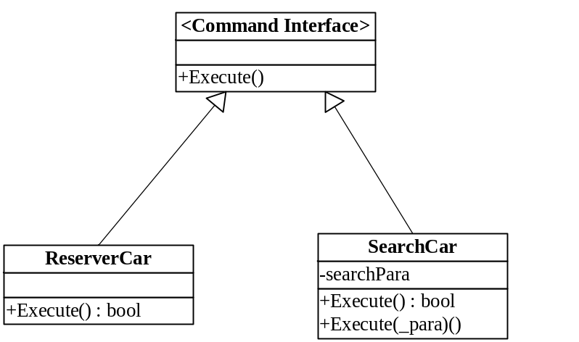
Design Patterns - Command
Diagram:
Improvement:
Notes:
Command Interface declares an interface for executing operations. In this system, this interface includes an abstract Execute operation. ReserverCar and SearchCar class works as a concrete command object implementation. These classes encapsulate all Executions to invoke the request.
These two classes are key to car rental flow in whole system. And they need to interact with other classes like user, car, and reservation classes. So through the command pattern, it makes the system framework clearer.

Slide 10
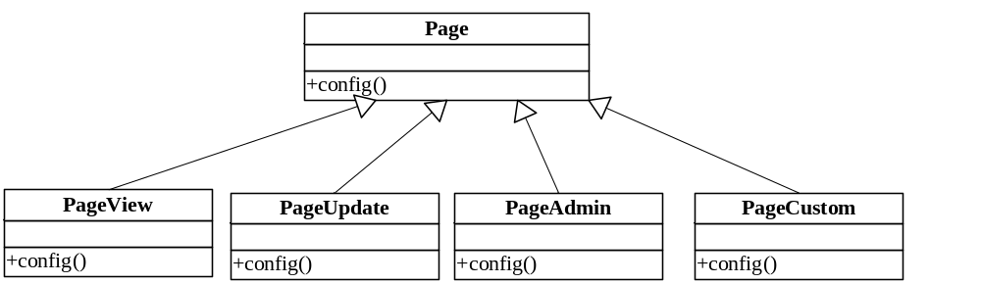
Design Patterns - Strategy
Diagram
Improvement
Notes:
Different users will own different page style. Through method of config() we can provide different implementations of the same behavior. In this systems, we provide the pageview strategy for guests, pageUpdate for member, pageAdmin for administrator.The pageCustom is applied in some uses who can custom their favorite interface style.

Slide 11
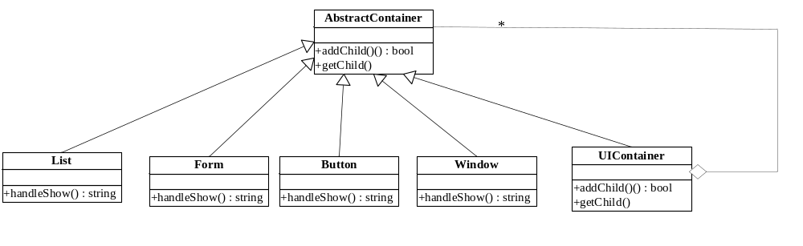
Design Patterns - Composite
Diagram
Improvement
Notes:
Abstract Container class defines an interface for accessing a component's parent in the recursive structure. Through composite pattern, window can contain List, Form, Button classes as its children. HandleShow method is responsible for show the detailed interface for every class.
Although visit every child using iterator, visiting nodes is not important issue here. So we don’t want to pay more attention to behavioral property. Here in composite pattern we want focus more on structural framework between interface classes.

Slide 12
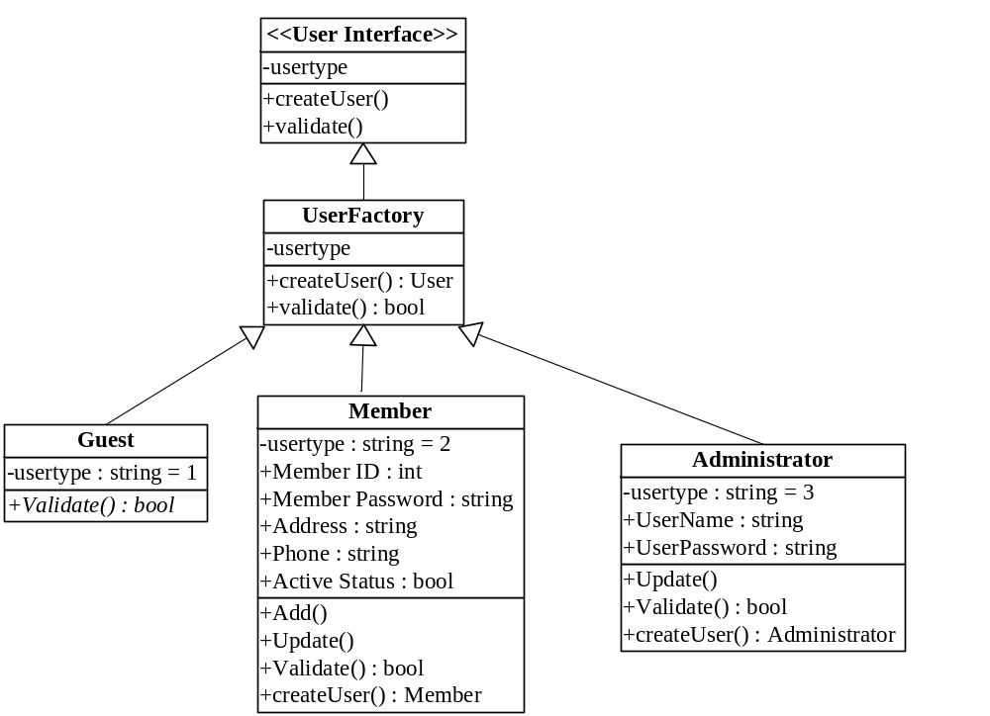
Design Patterns - Factory
Diagram
Improvement
Notes:
User Factory class can create different user class (guest class ,member class and administrator class) according to user types.

Slide 13
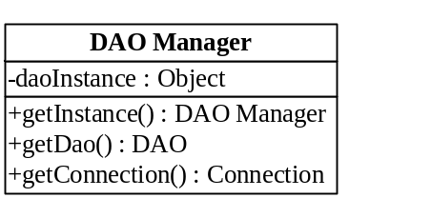
Design Patterns - Singleton
Diagram
Improvement
Notes:
The DAO Manager gets the sole instance through method “getInstance ()” in singleton pattern. We use the DAO manager to get DAO object which is the interface between system and database.

Slide 14
Questions?
Thank you!

